Slide 1
Session 12
Performing Tests
chengbaolei@suda.edu.cn

Slide 2
Objectives
In this session, you will learn:
Unit testing
Integration testing
System testing
Acceptance testing
Regression testing

Slide 3
Most development teams take the incremental view of testing.
Unit testing
Verification of isolated software units
Integration testing
Verification of the interaction among software units
System testing
Verification of the behavior of a whole system
Customers: acceptance testing

Slide 4
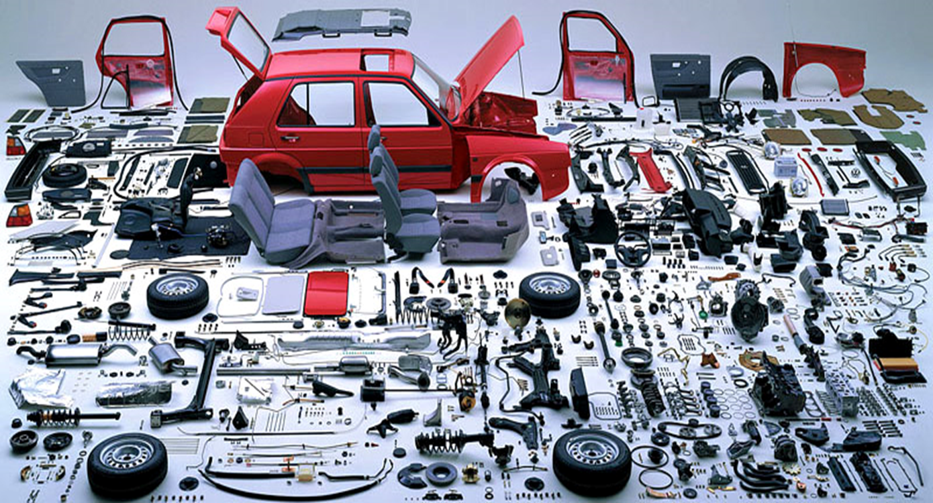
U-I-S-A

Slide 5
Unit Testing
Unit Testing
Unit Testing
Unit Testing
Unit Testing

Slide 6
Unit Testing
Unit Testing
Integration
Testing
Unit testing
Unit Testing
Unit Testing

Slide 7
System Testing

Slide 9
Objectives
Unit testing
Integration testing
System testing
Acceptance testing
Regression testing
5W+1H

Slide 10
Why we need Unit Testing
In the programming process, dozens of errors are made for every 1000 lines of code
About 2-6 bugs remain in every 1000 lines of code after compilation
The cost of testing and debugging accounts for 30%-60% of overall development cost
The earlier, the better

Slide 11
What is Unit Testing
Unit testing is a software development process in which the smallest testable parts of an application, called units, are individually and independently checked for proper operation.
A Unit may be
a program, a function, a procedure, a method, etc.

Slide 12
What is Unit Testing
Purpose of unit testing：
Discover the errors introduced during coding process.
Validate whether code is consistent with the design.
Trace the implementation of requirements and design.
Discover the errors among design and requirement.
Notes:
12
单元测试的目标就是确保模块被正确的编码。

Slide 13
单元测试的目标和任务
目标: 单元模块被正确编码
信息能否正确地流入和流出单元
在单元工作过程中，其内部数据能否保持其完整性，包括内部数据的形式、内容及相互关系不发生错误，全局变量在单元中的处理和影响
为限制数据加工而设置的边界处，能否正确工作
单元的运行能否做到满足特定的逻辑覆盖

Slide 14
How to do Unit Testing
Unit Testing
Static testing
It is primarily syntax checking of the code and/or manually reviewing the code or document to find errors.
This type of testing can be used by the developer who wrote the code, in isolation.
Peer reviews(同行评审), walkthroughs(走查) and inspections(审查) are also used.
Dynamic testing
Design and execute test cases
Tools: Junit, C++ Test, unittest(PyUnit), Pytest…
Notes:
14
Code review:代码审查

Slide 15

Peer reviews(同行评审)
一次检查少于200～400行代码
努力达到一个合适的检查速度：300～500LOC/hour
有足够的时间、以适当的速度、仔细地检查，但不宜超过60～90分钟
在复审前，代码作者应该对代码进行注释
使用检查表（checklist）能改进双方（作者和复审者）的结果
验证缺陷是否真正被修复
Best Practices for Peer Code Review ( www.SmartBearSoftware.com)

Slide 16
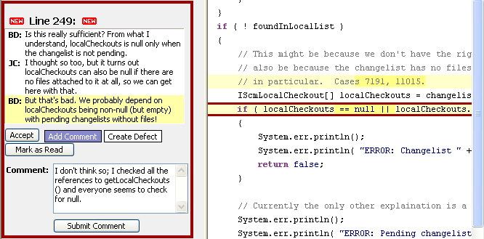

Peer review tool

Slide 17
Walkthroughs(走查)
定义：采用讲解、讨论和模拟运行的方式进行的查找错误的活动。
注意：
引导小组成员在走查前通读设计和编码。
限时，避免跑题
发现问题适当记录，避免现场修改
检查要点是代码是否符合标准和规范，是否有逻辑错误

Slide 18
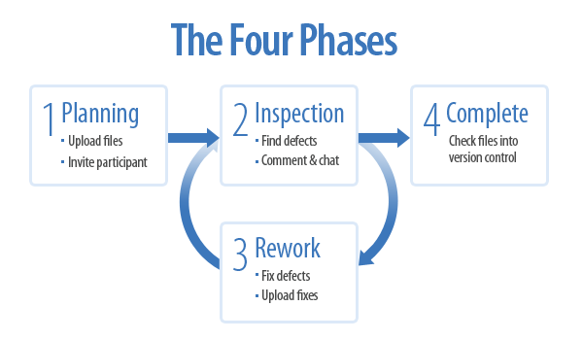
Inspections(审查)
以会议形式，制定目标、流程和规则
按缺陷检查表（不断完善）逐项检查
发现问题适当记录，避免现场修改
发现重大缺陷，改正后会议需要重开

Slide 19
Walkthroughs vs. Inspections
 | 走 查 | 审 查
准备 | 通读设计和编码 | 事先准备Spec、程序设计文档、源代码清单、代码缺陷检查表等
形式 | 非正式会议 | 正式会议
参加人员 | 开发人员为主 | 项目组成员包括测试人员
主要技术方法 | 模拟运行 | 缺陷检查表
生成文档 | 会议记录 | 静态分析错误报告
目标 | 代码标准规范 无逻辑错误 | 代码标准规范 无逻辑错误

Slide 20
示例：单元测试检查表
关键测试项是否已纠正
有无任何输入参数没有使用？有无任何输出参数没有产生？
有无任何数据类型不正确或不一致？
有无任何算法与PDL或功能需求中的描述不一致？
有无任何局部变量使用前没有初始化？
有无任何外部接口编码错误？即调用语句、文件存取、 数据库错误。
有无任何逻辑路径错误？
该单元是否有多个入口或多个正常的出口？
额外测试项
该单元中有任何地方与PDL与PROLOG中的描述不一致？
代码中有无任何偏离本项目标准的地方？
代码中有无任何对于用户来说不清楚的错误提示信息？
如果该单元是设计为可重用的，代码中是有可能妨碍重用的地方？

Slide 21
Driver
Executing Unit Testing (Contd.)
Unit to be tested
Interface
Stub
Stub
Test Case
Results
Unit Test Environment
Notes:
21

Slide 22
Unit Testing Strategies
Driver：is used to simulate superior module of tested module. It receives testing data, transmits related data to tested module, starts tested module and prints corresponding results.
Stub：is used to simulate the calling modules in tested module. Generally, they only process few data.

Slide 23
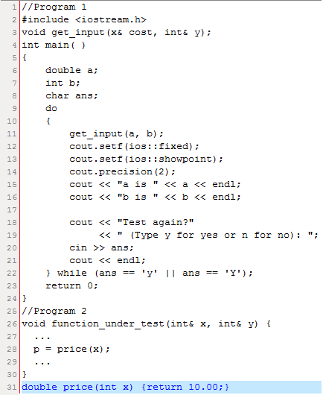
Driver
Function under test
Stub

Slide 24
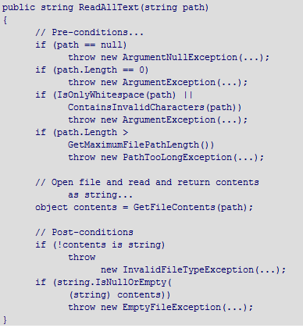
前置条件和后置条件
前置条件示例：
Contract.Requires( x != null );
后置条件示例：
Contract.EnsuresOnThrow<T>( this.F > 0 );
Contract. Result<T>()
http://msdn.microsoft.com/zh-cn/library/dd264808.aspx

Slide 25
单元测试常用工具简介
代码规则/风格检查工具
内存资源泄漏检查工具
代码覆盖率检查工具
代码性能检查工具

Slide 26
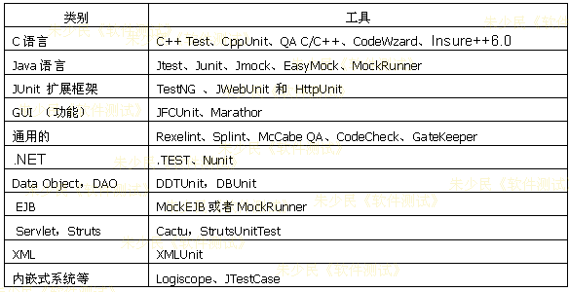
单元测试工具列表

Slide 27
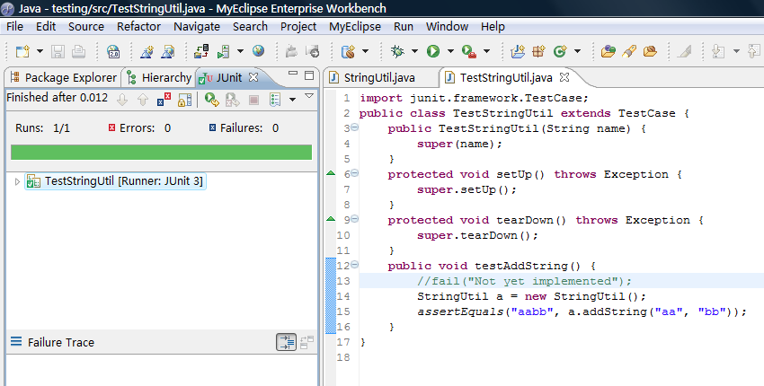
在Eclipse中JUnit应用举例
http://www.junit.org/apidocs/overview-summary.html

Slide 28
Objectives
Unit testing
Integration testing
System testing
Acceptance testing
Regression testing

Slide 29
Unit Testing
Unit Testing
Integration
Testing
Unit testing
Unit Testing
Unit Testing

Slide 30
Integration Testing Introduction
Integration testing （集成测试）
It is the phase of software testing in which individual software modules are combined and tested as a group.
Integration testing focuses on testing multiple components that work together.

Slide 31
Integration Testing Strategy
Describe module integration (assembly) approach.
How to combine the modules of the system? All at the same time assembly or gradually assembled?
The non-incremental integration strategy -- in one go
Incremental integration strategy -- gradually realize

Slide 32
Integration Testing Strategy
基于分解的集成
Big bang（大爆炸） integration
Top-down （自顶向下）integration
Bottom-up （自底向上）integration
Sandwich（三明治） integration

Slide 33
Integration Testing Strategy
Big Bang integration
It is a non-incremental integration method, it integrates all system components together at one time, not considering the dependence of components and the possible risk.
Strategy:
A
d1
d2
d3
d4
d5
B
C
D
B
D
C
E
F
A
E
F
s1
s2
s3
s4
s5

Slide 34
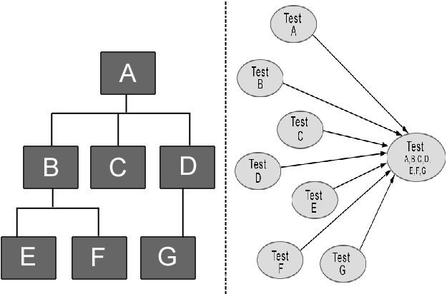
先对每一个子模块进行测试（单元测试阶段）
然后将所有模块一次性的全部集成起来进行集成测试 。

Slide 35
Integration Testing Strategy
Advantage
Integration testing can be completed rapidly and only few stubs and drivers are needed.
Several testers can work in the parallel way, and human and material resources utilization is higher.
Disadvantage
localization and debug more difficultly when error found.
Many interface errors can not be found until system testing.

Slide 36
Integration Testing Strategy
Scope
Existing system with only minor modifications
Small systems with adequate unit testing
System made from certified high quality reusable components

Slide 37
Integration Testing Strategy
Top-down integration
（1）Focus on the top level components firstly, then gradually test the bottom of components.
（2）Depth-first and breadth-first strategy can be used.
（3）Conduct regression testing, exclude possible errors caused by integrated.
（4） All modules are integrated into the system then finish testing, otherwise turn to （2）.

Slide 38
Integration Testing Strategy
Strategy：Depth-first assembly
A
A
A
B
s2
s3
B
s2
s3
s1
s2
s3
E
s4
A
A
A
B
C
s3
B
C
D
B
C
D
E
E
s5
E
F

Slide 39
Integration Testing Strategy
Strategy：Breadth-first assembly
A
A
A
B
C
s3
B
s2
s3
s1
s2
s3
s4
s4
A
A
A
B
C
D
B
C
D
B
C
D
s4
s5
E
s5
E
F

Slide 40
Integration Testing Strategy
Bottom-up integration
Start from the bottom with minimal dependent components, according to dependency structure, layers upward integration to detect the entire system.

Slide 41
Integration Testing Strategy
Bottom-up integration

Slide 42
Integration Testing Strategy
Sandwich integration
Combine the advantage of top-down strategy and bottom-up strategy.

Slide 43
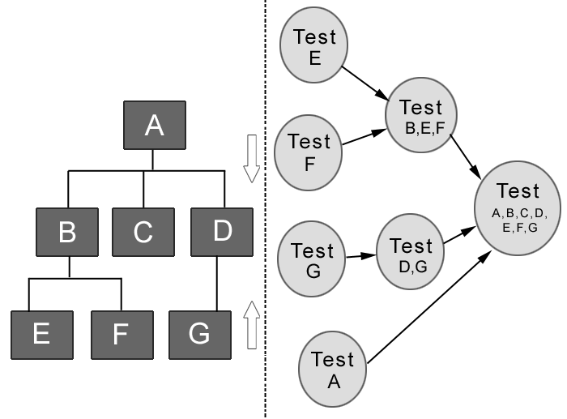
Integration Testing Strategy
Sandwich integration
在真正集成之前每一个独立的模块没有完全测试过。

Slide 44
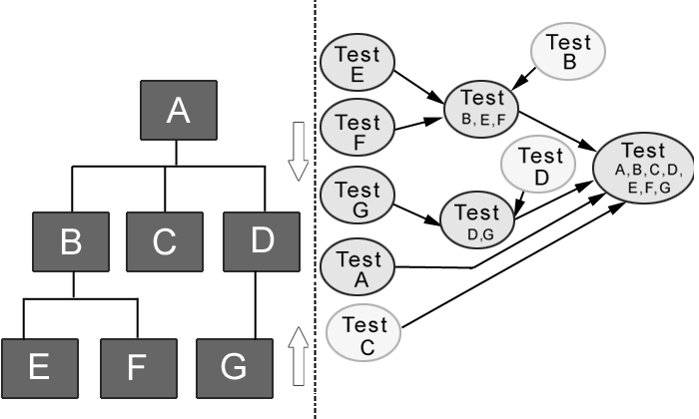
Integration Testing Strategy
Improved Sandwich integration
保证每个模块得到单独的测试，使测试进行得比较彻底 。

Slide 45
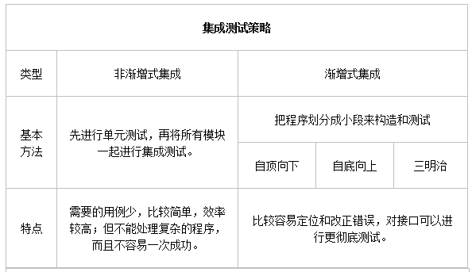
Integration Testing Strategy

Slide 46
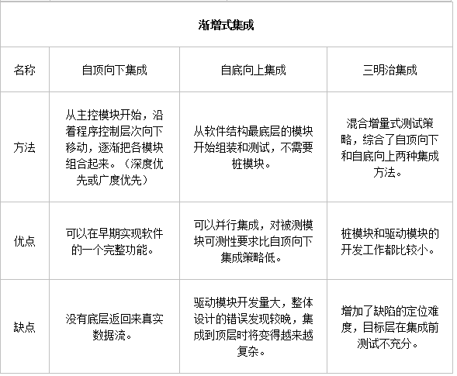
Integration Testing Strategy
改进的三明治集成

Slide 47
Integration Testing Strategy
基于分解的集成—更关注结点
Big bang（大爆炸） integration
Top-down （自顶向下）integration
Bottom-up （自底向上）integration
Sandwich（三明治） integration
基于调用图的集成—更关注边
成对集成
相邻集成

Slide 48
基于调用图的集成
成对集成
免除桩/驱动模块的开发工作 ，使用实际的代码
为避免大爆炸集成 ，限制在调用图的一对单元上
对调用图中的每条边有一个集成测试过程
相邻集成
借用拓扑学中的邻接概念
在有向图中，结点邻居包括所有直接前驱结点和所有直接后继结点
对应结点的桩和驱动模块集合

Slide 49
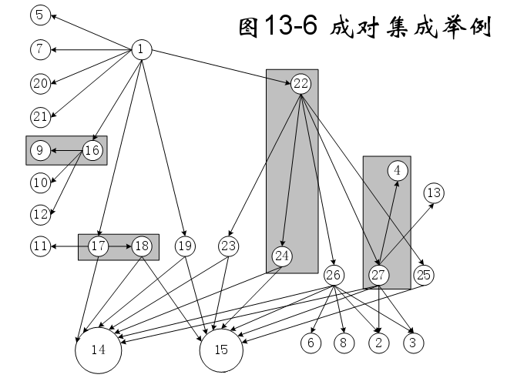
成对集成示例
40次集成测试会话

Slide 50
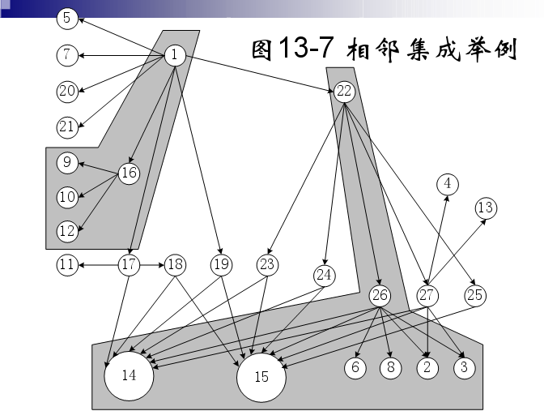
相邻集成示例
5

Slide 51
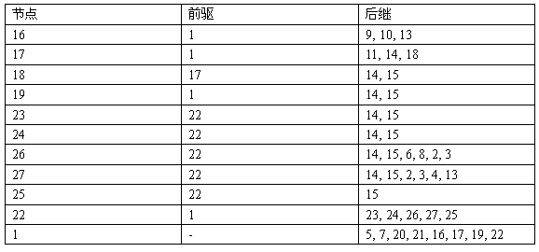
12
11次集成测试会话

Slide 52
成对集成，相邻集成分别需要多少次测试会话？

Slide 53
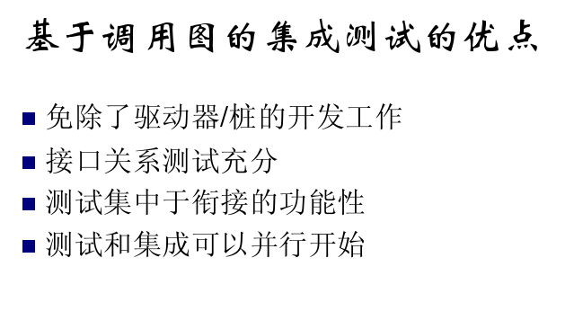

Slide 54
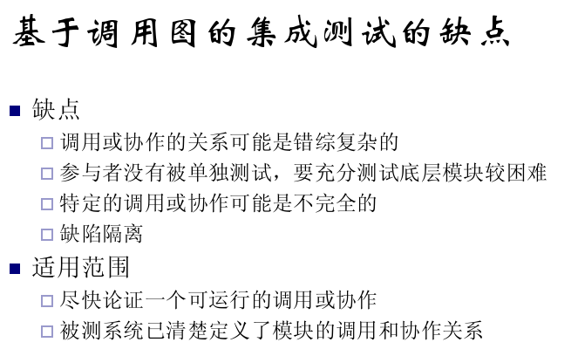

Slide 55
其他集成测试策略
基于功能优先级的集成
依据功能的优先级，逐一将某个功能上的各个模块集成起来
核心系统先行集成测试
基于进度的集成
将最早获得的模块进行集成，以最大程度保持与开发的并行性
高频集成

Slide 56
高频集成
高频集成测试是指同步于软件开发过程，每隔一段时间对开发团队的现有代码进行一次集成测试。
该集成测试方法频繁地将新代码加入到一个已经稳定的基线中，以免集成故障难以发现，同时控制可能出现的基线偏差。

Slide 57
高频集成
使用高频集成测试需要具备一定的条件:
可以持续获得一个稳定的增量，并且该增量内部已被验证没有问题;
大部分有意义的功能增加可以在一个相对稳定的时间间隔（如每个工作日）内获得;
测试包和代码的开发工作必须是并行进行的，并且需要版本控制工具来保证始终维护的是测试脚本和代码的最新版本;
必须借助于使用自动化工具来完成。

Slide 58
高频集成
优点：能在开发过程中及时发现代码错误，能直观地看到开发团队的有效工程进度。
缺点：需要开发和维护源代码和测试包。

Slide 59
Principle of Integration Testing
Key modules must be tested sufficiently. 20-80
All interfaces must be tested.
When the interface is changed, all related interfaces should be tested by using regression testing.
Integration testing is conducted according to plan and prevents random testing.
Integration testing strategy should integrate the relationship among quality, cost and progress.

Slide 60
Objectives
Unit testing
Integration testing
System testing
Acceptance testing
Regression testing

Slide 61
System Testing Concepts
Unit Testing
Unit Testing
Unit Testing
Unit Testing
Unit Testing

Slide 62
System Testing Concepts
Unit Testing
Unit Testing
Integration
Testing
Unit testing
Unit Testing
Unit Testing

Slide 63
System Testing Concepts
System Testing

Slide 64
System Testing Concepts
Why is system testing necessary?
Some properties only verifiable at system level
We may involve users at this level
The environment of the system is taken into account

Slide 65
System Testing Concepts
System testing is the process of testing a fully integrated system to verify if it meets the specified requirements.
It also determines if the system successfully integrates with the business procedures and the environment.

Slide 66
System Testing Concepts
System testing process
System functional requirements
Other
software requirements
Customer requirements
specification
User
environment
Function Test
Non-functional Test
Acceptance Test
Installation Test
Functioning system
Verified
validated
software
Accepted system
Integrated
modules
System in use

Slide 67
System Testing Methods
GUI software testing
Usability testing
Performance testing
Compatibility testing
Load testing
Volume testing
Stress testing
Security testing
Scalability testing
Sanity testing
Smoke testing
Exploratory testing
Ad hoc testing
Regression testing
Reliability testing
Recovery testing
Installation testing
Maintenance testing
Accessibility testing

Slide 68
Objectives
Unit testing
Integration testing
System testing
Acceptance testing
Regression testing

Slide 69
Acceptance Testing
Introducing Acceptance Testing
Acceptance testing is a formal testing conducted to determine whether the software satisfies the acceptance criteria defined by the customer in the requirements phase of the SDLC.
The end user or customer can conduct acceptance testing to validate whether or not to accept the product.
交付测试

Slide 70
Acceptance Testing
Types of Acceptance Testing
There are two types of acceptance testing:
Alpha testing:
Alpha testing is a simulated or actual operational testing at an in-house site close to the development team.
This type of testing helps evaluate the software to ascertain whether or not it meets all the requirements specified in the requirements analysis phase.
Beta testing:
Beta testing involves operational testing of the software at a site away from the developers or at the customer site.

Slide 71
Acceptance Testing
α测试：早期的、不稳定的软件版本所进行的验收测试，受控的实验室测试
β测试：晚期的、更加稳定的软件版本所进行的验收测试，不受控的非实验室测试

Slide 72
Acceptance Testing
β测试的局限性：
β测试通常不是专业测试人员，问题往往停留在易用性上；
环境不可控，使用不当引起的问题居多；
为了评价软件或获得软件而参与测试；
反馈信息简单，经常无法重现。
众包测试/群体智能的兴起

Slide 73
测试步骤 (Testing life cycle)
制定测试计划及验收通过准则，通过客户评审
设计测试用例并通过评审
准备测试环境与数据，执行测试用例，记录测试结果
分析测试结果，根据验收通过准则分析测试结果，作出验收是否通过及测试评价。
测试项目通过；
测试项目没有通过，但存在变通方法，在维护后期或下一个版本改进；
测试项目没有通过，并且不存在变通方法，需要很大的修改；
测试项目无法评估或者无法给出完整的评估。此时须给出原因
提交测试报告

Slide 74
Compare unit testing vs. integration testing vs. system testing vs. acceptance testing:
Level
Action
Actor
Method
5W+1H

Slide 75
Objectives
Unit testing
Integration testing
System testing
Acceptance testing
Regression testing

